Slide 1

Presented by
Group-7
1711027
1711032
1711037
1711042
1711047
ANTI-KNOCK VALUE
& REQUISITES OF GOOD
QUALITY GASOLINE

Slide 2

TABLE OF CONTENTS
KNOCKING
ANTI-KNOCKING
VALUE
01
03
Definition, Reasons, Effect
Definition, Order, Cetane
Number, Advantages
OCTANE NUMBER
GASOLINE
02
04
Definition, Determination,
Advantages, Disadvantages
Production, Requisites of
Good Quality Gasoline,
Uses of Fuel

Slide 3
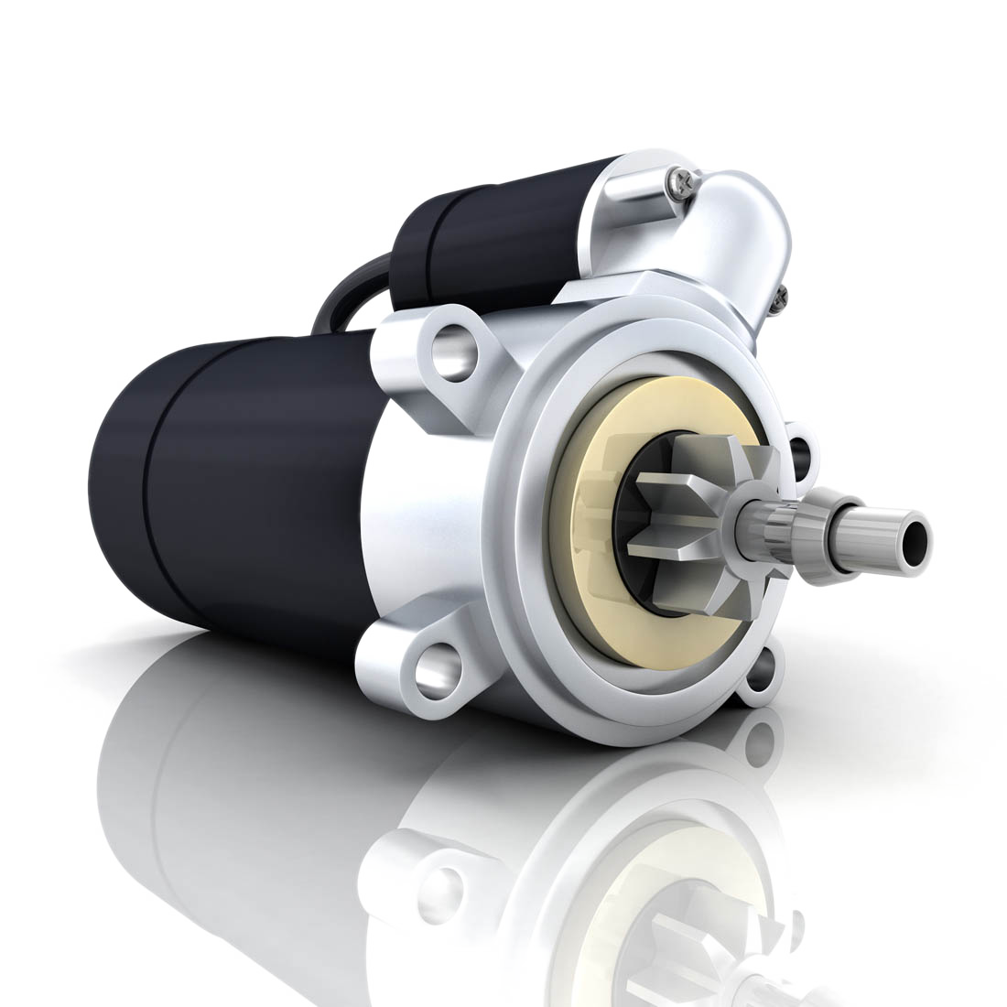
01
KNOCKING
The rattling noise produced from the combustion chamber of an engine.
It was first observed by Harry Ricardo
between 1916 and 1919.

Slide 4
02
WHAT CAUSES KNOCKING
IN PETROL ENGINE
IN DIESEL ENGINE
Preignition
Imbalanced combustion
Delay of ignition

Slide 5

03
OTHER REASONS
Contaminated fuel
Characteristics of fuel
Design operation of engine

Slide 6

04
EFFECTS OF KNOCKING
Reduces engine life
Lowers the efficiency of engine
Results in wear and tear of engine parts

Slide 7
05
OCTANE NUMBER
A figure indicating the anti-knock properties of a fuel, based on a comparison with a mixture of isooctane and n-heptane.
The octane number of n-heptane is assigned 0.
The octane number of isooctane is assigned 100.

Slide 8
06
Example-
Octane number 80 means it gives as much knocking as 80% isooctane and 20% normal heptane.
The greater the octane number, the better-quality fuel it is.

Slide 9

07
DETERMINATION OF OCTANE NUMBER
Three methods are used-
Motor Method
Research Method
Aviation Method

Slide 10
08
Fuel is burnt
Knockmeter
Reading is matched with standard chart
Process-

Slide 11

09
ADVANTAGES OF HIGH OCTANE NUMBER
Increase in cruising speed
Decreases takeoff distance
Increase in payload weight
Octane number can be increased by adding Tetra Ethyl Lead (TEL) to fuel.

Slide 12
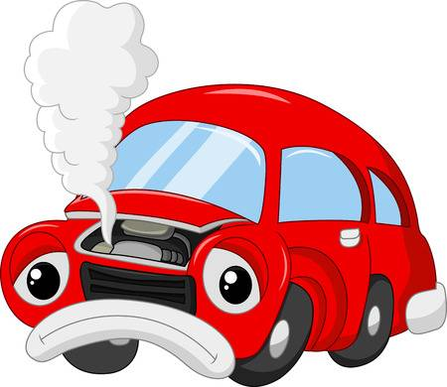
10
DISADVANTAGES OF HIGH OCTANE
NUMBER
Gum formation
Susceptible to pre-ignition

Slide 13
11
ANTI-KNOCKING VALUE
Anti-knock value is the measure of resistance to knocking.
Anti-knocking value increases when-
Molecules are compact
Fuel component has cyclic structure
Fuel component contains double bond

Slide 14
12
Order of anti-knock value-
Aromatics > iso-paraffins > napthenes > olefins > paraffins

Slide 15


13
OCTANE NUMBER OF BLENDS
Paraffin – Paraffin
Paraffin – Aromatics
Paraffin - Olefins

Slide 16
14
CETANE NUMBER
Measure of knocking in a diesel engine, relative to cetane (C₁₆H₃₄) as a standard.
Order of cetane number-
Paraffins > olefins > napthenes > iso-paraffins > aromatics
High octane number has a low cetane number and vice-versa.

Slide 17
15
ADVANTAGES OF HIGH CETANE NUMBER
Faster engine starting
Faster engine warm up
Reduced exhaust smoke
Increased engine efficiency
Improved combustion control

Slide 18
16
PRODUCTION OF GASOLINE
Gasoline is another name for Petrol.
The following production methods are followed-
PROCESS | PRODUCT
Distillation of crude oil | Straight run gasoline
Cracking of fuel oil | Cracked gasoline
Alkylation of refinery gases | Gasoline
Reforming of heavy gasoline and naphtha | Reformed gasoline
Condensation of natural gas | Natural gasoline

Slide 19
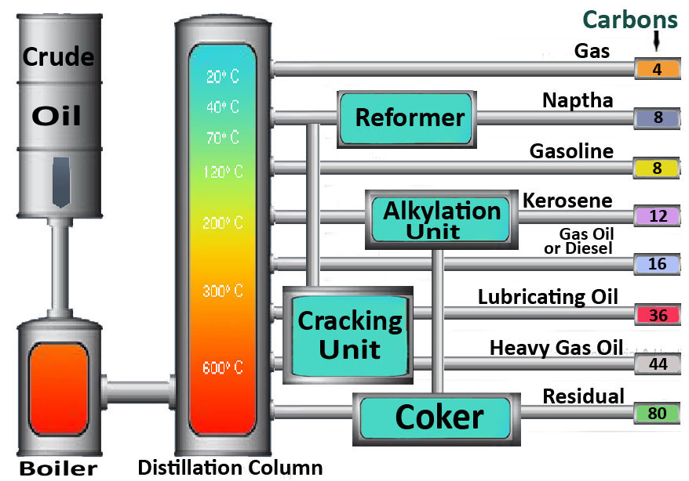
17

Slide 20
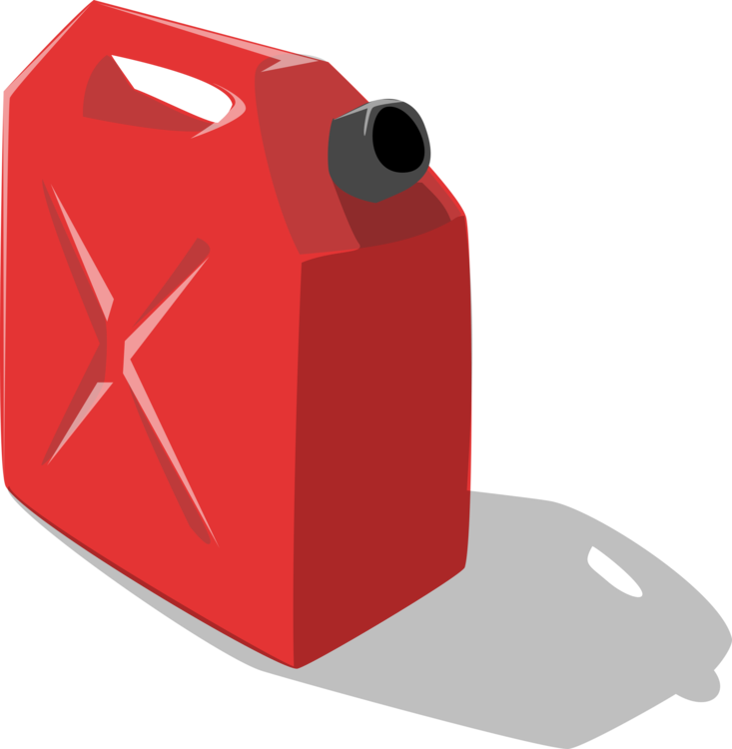
18
REQUISITES OF GOOD GASOLINE
High calorific value
Low freezing point
Optimum flash point
Controlled volatility
Limited vapor pressure

Slide 21
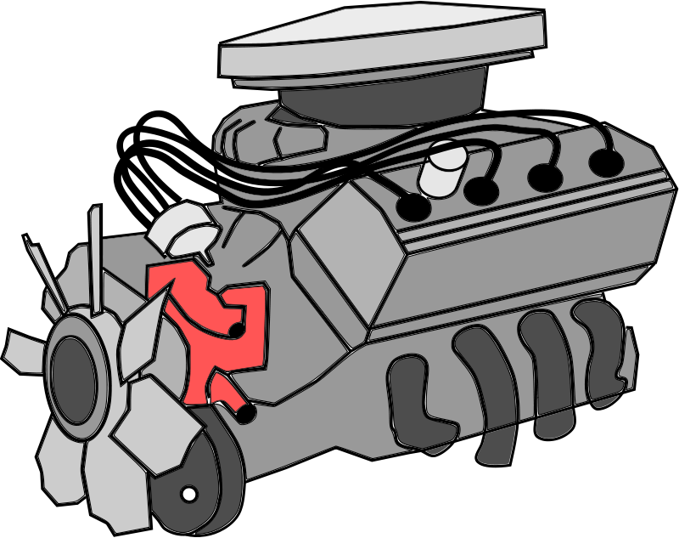
19
USES OF DIFFERENT TYPE OF FUELS
GASOLINE
DIESEL
Fuel for IC engine
Aviation fuel
Automobiles
Power generators
Industrial application

Slide 22
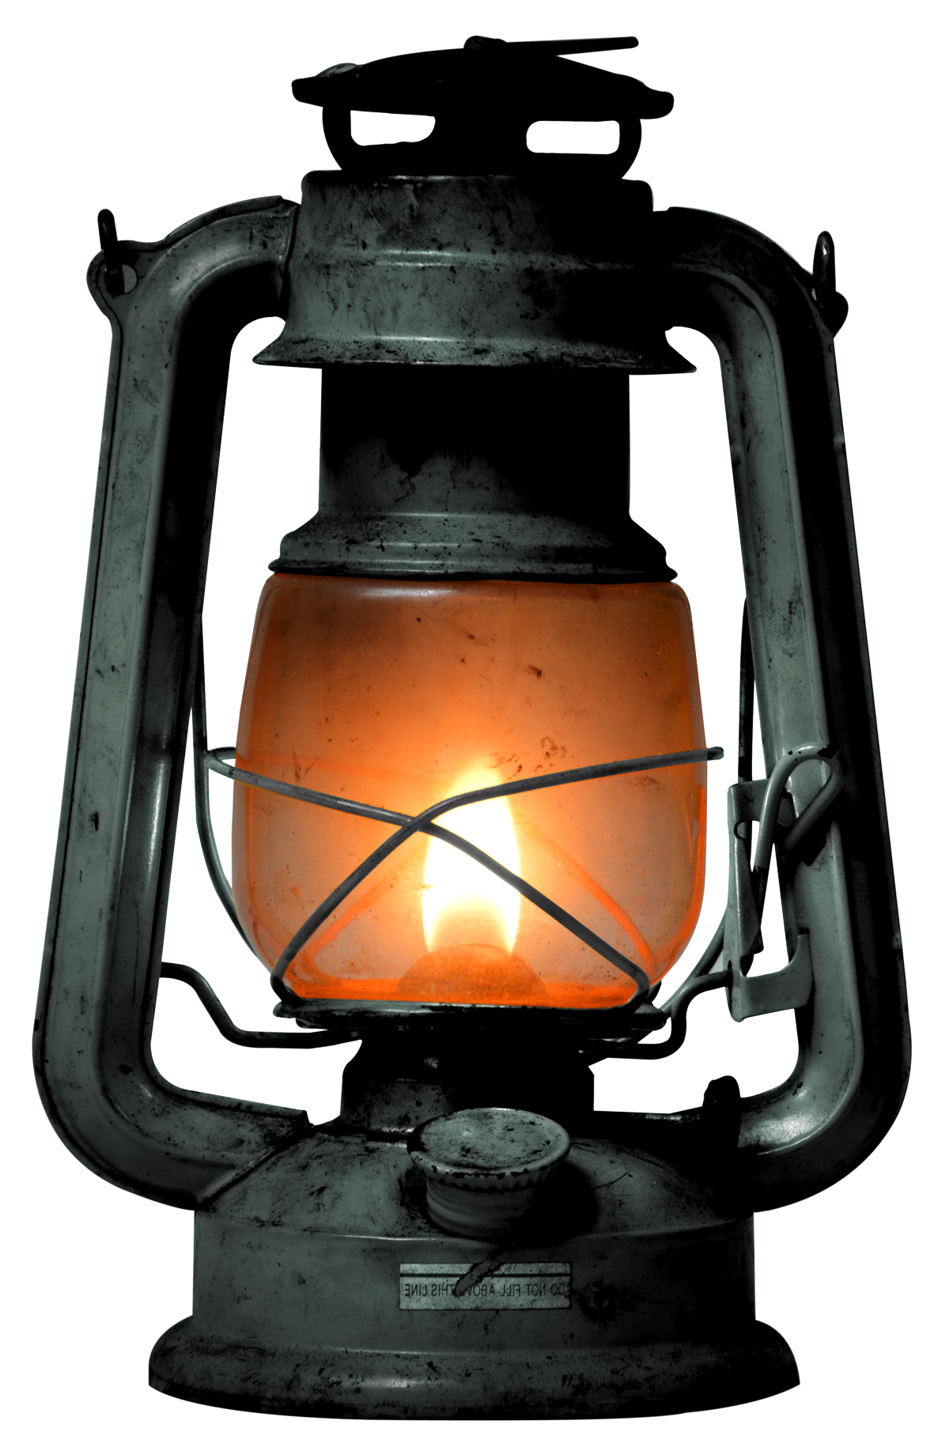
20
NAPTHA
KEROSENE
Jet fuels
Used as solvent
Producing synthesis gas
Domestic fuel
Lighting purpose
Manufacturing insecticides

Slide 23


